Slide 1
IFMA’s Strategic Themes

Slide 3
Evolution is never finished
Insights from IFMA’s Emerging Topics Working Group on How Six Key Topics are Transforming the FM Industry

Slide 4
Emerging Topics Transformational Issues
Figure: IFMA’s Emerging Topics Transforming FM industry
Engage the Industry
The International Facility Management Association (IFMA) and its Emerging Topics Working Group (ETWG) want to engage with the broader FM community concerning high-impact, emerging topics (see figure right).
These topics require different responses from FMs to navigate successfully. The emerging topics presented in this paper focus on complex issues for which industry-wide "best" or "good" practices have not yet been developed or identified.
PropTech
AI & Generative AI
Contending with Climate Change
Circular Economy
ESG Reporting
Wellness & Wellbeing
Notes:
The International Facility Management Association (IFMA) and its Emerging Topics Working Group want
to highlight their transformational potential for the facility management (FM) industry.
Over the past year, the Emerging Topics Working Group has met regularly through large and sub-working groups to identify and explore the implications of these topics on the industry. The emerging topics

Slide 5
PropTech
What is it?
Property technology, or PropTech, utilizes technology to manage and optimize real estate operations.
PropTech is transforming the FM industry by allowing FMs to gather and analyze data, automate routine tasks, and enhance sustainability efforts.
The 4th Industrial Revolution is changing the industry by fusing digital, biological and physical worlds. The 5th Industrial Revolution enables workers to work with and alongside machines through AI and cobotics. As a result, organizations face a dizzying array of technology opportunities.
As PropTech automates and augments, FM organizations and workers will do once impractical things, requiring new business models, skills and competencies.
PropTech assists FM through:
Information for action by gathering and analyzing data through sensors and other monitoring devices
Automating routine tasks and faster and more secure transactions
Greater management control via new interfaces and dashboards
Greater interactivity with prosumers

Slide 6
PropTech
What does it mean for FM?
People: FM groups will require tech-savvy individuals to make the most of new opportunities. However, hiring skilled tech experts will be costly. Proper training and education are necessary to operate and maintain tech solutions. FMs need to consider training. Sometimes, using automation can reduce on the job learning chances for newer, younger workers.
Place: PropTech optimizes the use of space by using sensors and other monitoring devices to track occupancy and usage patterns. This information will enable tenant engagement and new forms of service design and delivery through apps and new interfaces.
Process: Core process automation, connected operations, and data-driven decision-making will enable FMs to streamline and automate processes to improve efficiency and reduce environmental impacts. Prop and other technologies will allow the transition to more circular operations.
Technology: PropTech is rapidly evolving. This requires a willingness to experiment and learn new things. It also requires focusing on cyber safety as integrating technologies creates vulnerabilities that must be addressed.
Procurement: A literature review of technology procurement success rates is alarming. Most projects fail because of unclear objectives, confusion over roles and responsibilities, and lack of stakeholder involvement.
Leadership: The application of PropTech is about leadership. FMs need to have a vision and strategy for the future direction of their team to select the best technologies to help them do so.

Slide 7
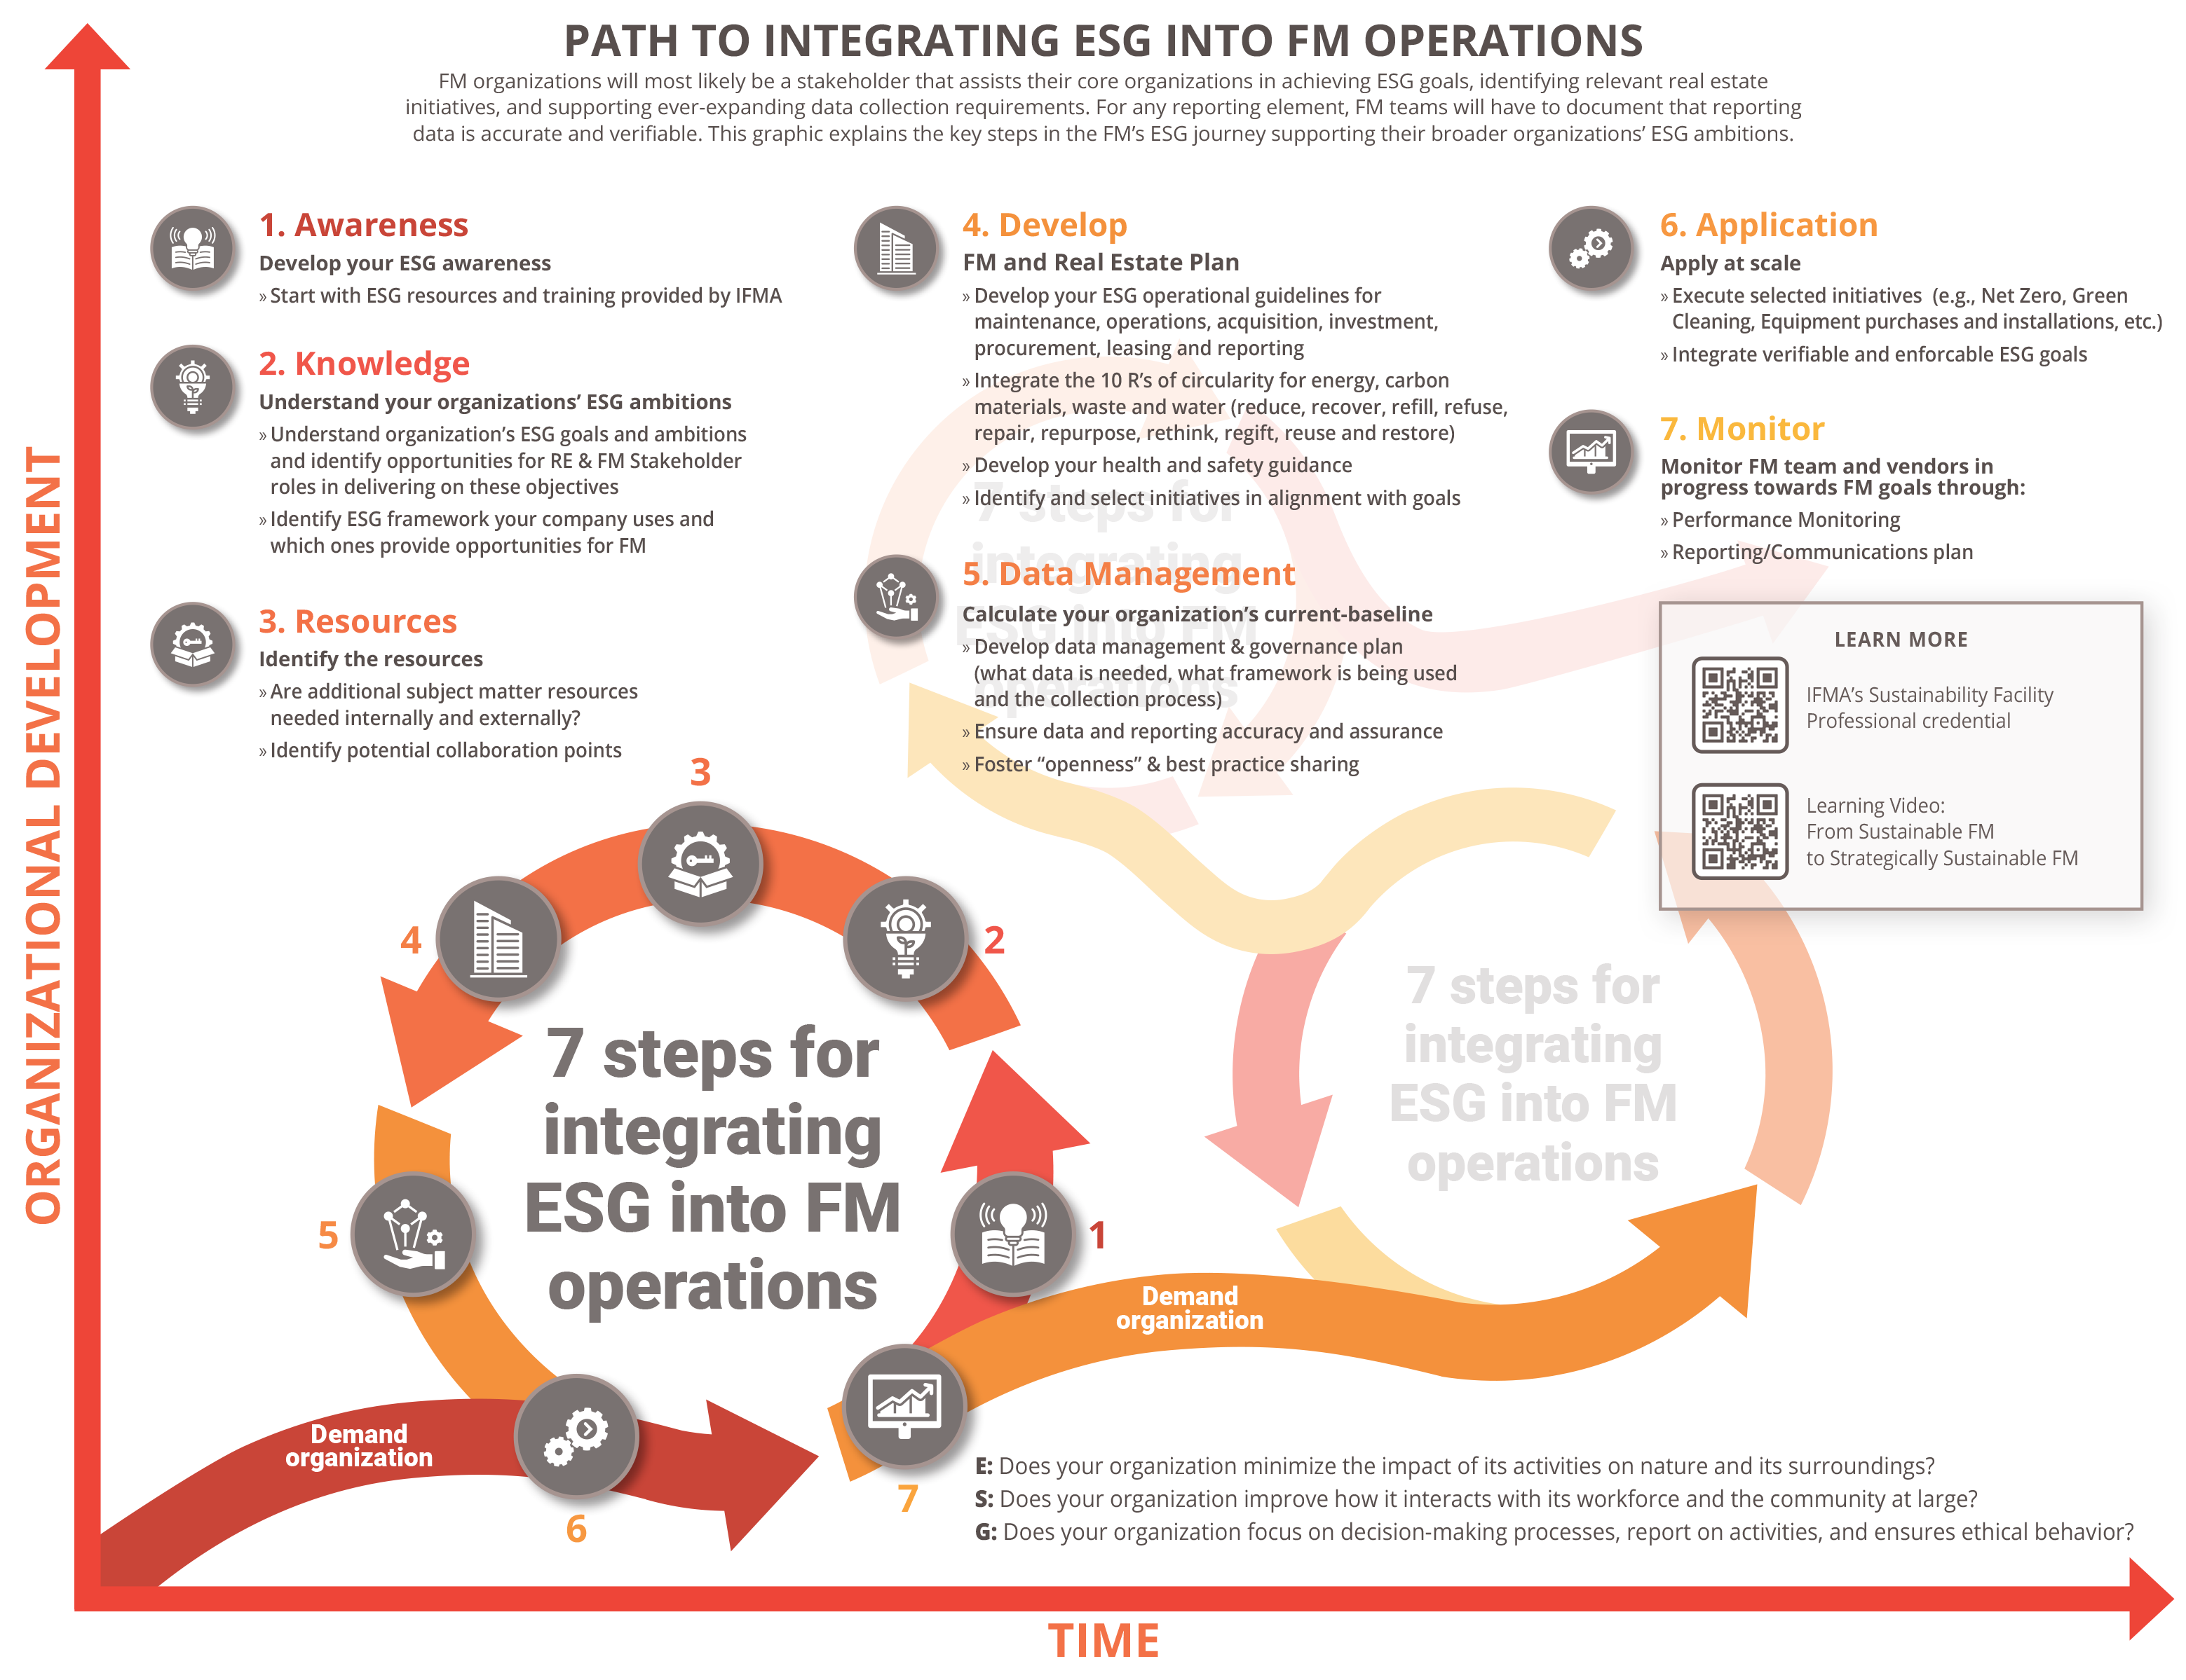
ESG Reporting
What is it?
ESG stands for Environmental, Social, and Governance.
ESG consists of a set of standards that organizations use to evaluate and communicate their commitments and performance to their stakeholders in these areas over time.
Reporting on E, S, and G includes collecting and disseminating data on issues like:
E - waste reduction, energy efficiency, water conservation, emissions reduction, green building design and operations, climate risk mitigation, and biodiversity protection.
S - occupational health and safety, good occupant health, employee welfare, community engagement and impact, and diversity and inclusion
G - decision-making and risk management processes, activities, and ethical behavior.
visit ifma.org/esg for more information

Slide 8
ESG Reporting
What does it mean for FM?
People: FMs will need to be more aware of the environmental and social impacts of their work and be able to communicate these to stakeholders. FM teams will require new skills and competencies in data collection, management and analysis.
Place: FMs will have to ensure and prove that their buildings are energy, water, and waste-efficient and that they are healthy and comfortable workplaces for their employees.
Process: ESG reporting will have significant impacts on processes. FMs must understand their organizations' ESG ambitions, develop their FM teams' ESG strategy, and integrate their ESG strategies into their FM processes. To ensure accuracy, FMs will have to incorporate data management covering collection, accuracy, assurance, and analysis. FMs will have to monitor and evaluate performance to meet ever-evolving goals and targets.
Technology: FMs will use technologies to assist in data collection, analysis, visualization, and reporting in meaningful and actionable ways. ESG data must be transmitted in compatible formats to other departments.
Procurement: ESG reporting will have impacts up and down the value chain. Just as FMs will have to report their progress to the core organization, vendors and contractors will have to register their progress to FM teams. Suppliers and vendors will be selected based on their ESG performance.
Leadership: FMs will need to set clear objectives for their organizations and continuously communicate these goals to their employees.

Slide 9
Circular Economy
What is it?
The circular economy (CE) is a way of thinking about how we use resources. It is different from the linear and reuse economies.
It's about finding ways to keep things in use for as long as possible, instead of throwing them away.
Ideally, there should be no discarded waste in a CE. CE can help us reduce waste, save money, and protect the environment.
CE is a model of production and consumption that aims to keep resources in use for as long as possible, extract the maximum value from them, recover and regenerate products and materials at the end of each service life to regenerate natural systems.
New building, product, and service designs based on CE approaches are based on the principle that waste and pollution are flaws that must be eliminated. The transition to circular thinking requires rethinking, retraining, reframing, and re-educating.
In practice, facility managers will:
reuse and recycle materials,
use sustainable products,
operate and retrofit buildings to be more efficient, and
repair and reuse equipment.

Slide 10
Circular Economy
What does it mean for FM?
People: CE will require a shift in mindsets among FMs and their teams. They must be more creative in finding ways to repair, reuse and recycle materials, necessitating education of and collaboration with end-users, vendors and contractors.
Place: Buildings will need to be designed and constructed in a way that minimizes waste and pollution. They will also need to be equipped with systems that can recover and reuse materials.
Process: CE is a holistic approach to sustainability, and FMs will have to change how they manage buildings. FMs should adopt a facility waste reduction strategy, including reducing, reusing, refurbishing, and recycling materials. FMs should also consider product, building and service lifecycles.
Technology: Facility managers will need to use technology to track and manage materials, identify opportunities for reuse and recycling, and connect with other stakeholders. Technologies include building information models and materials passports supported by distributed ledger technologies.
Procurement: Many procurement practices will transition from acquisition to “as a service”– e.g., furniture, carpet, ceiling, equipment lighting. FMs need to be knowledgeable about options and work closely with procurement on changing how the built environment is serviced.
Leadership: CE is a complex and challenging concept. FMs have a key role to play in making CE a reality. It will require experimentation, risk taking, change management and training.

Slide 11
Climate Change
What is it?
Climate change is the ongoing rise of the average temperature of the earth's climate system, which direct temperature measurements have demonstrated.
Studies estimate that the extraction and burning of fossil fuels have caused the atmospheric concentration of CO2 to increase by 50% since the beginning of the industrial age. Climate change is affecting weather patterns, population centers, agriculture, human health, and the accessibility of freshwater. Consequently, climate change has significant direct and indirect impacts on the FM profession today.
Buildings are contributors to and suffer impacts from climate change.
Buildings are responsible for 18% of US primary energy use, 35% of electricity consumption, and 16% of CO₂ emissions.
Building operations account for 80-85 % of real estate’s total energy usage.
Buildings, occupants and processes are at risk from more powerful storms, flooding, wildfires, heat waves, and drought.

Slide 12
Climate Change
What does it mean for FM?
People: More extreme weather events will impact the health and safety of building occupants and FM workers and spread diseases, especially mosquito-borne.
Place: Sea level rise, more extreme weather events, more favorable conditions for wildfires will harm buildings, infrastructure, and occupants. FMs will be responsible for conducting Climate Risk Assessments and making recommendations to mitigate or minimize assessed risks to their portfolio.
Process: Climate change will force FMs to rethink energy, water, and waste management approaches, leading to a greater uptake of circular business practices. FMs will need to develop a prioritized list of capital plans and facilities operations tactics on progress/carbon reduction, impact, and cost.
Technology: Climate change will drive the development of new technologies to help facility managers reduce their environmental impact and prepare for extreme weather events.
Procurement: Emerging regulations and company policies will compel facility managers to reconsider their procurement practices and consider the environmental impact of their suppliers.
Leadership: FM will participate in developing organization’s greenhouse gas emissions baseline and goalsetting and participate in cross-functional ESG teams. FMs will have to communicate effectively with stakeholders on climate issues.

Slide 13
Wellness & Wellbeing
What is it?
Wellness describes an individual’s physical, mental and emotional health so that they can do want they want in their life.
Wellbeing emphasizes broader, long-term dimensions of a well-lived life and include general health and life satisfaction.
The pandemic exposed the vulnerability and risk associated with a lack of employee health and resilience. Since the pandemic, incidences of mental illness, isolation, obesity, and other issues have increased.
Facilities managers’ focus on occupants’ wellness and wellbeing is essential. Employees with higher levels of wellness and wellbeing are more productive, have fewer absences and are less prone to work-related injury.
We spend on average 90% of our time indoors.
As a result, the built environment can impact wellness and wellbeing positively or negatively through the following areas air, water, nourishment, light, fitness, and mind.

Slide 14
Wellness & Wellbeing
What does it mean for FM?
People: FM will need to work holistically and be more proactive in understanding the needs of employees and occupants and in managing facilities that support their physical, mental, and emotional well-being. This includes developing stakeholder management skills and the cross-functional partnerships necessary for holistic solutions.
Place: FM will need to consider the impact of the physical environment on wellness. They will also need to ensure facilities are accessible to people with disabilities.
Process: FM must develop new processes for managing wellness initiatives, such as tracking employee health data and providing feedback on wellness programs. They will also need to work with other departments, such as human resources and IT, to ensure that wellness is a priority across the organization.
Technology: FM will need to use technology to better link building data with occupant performance. They will also need to use technology to monitor the physical environment and identify potential hazards.
Procurement: FM will need to procure products and services that support wellness, such as healthy food options, ergonomic furniture, and air purification systems. They will also need to consider the environmental impact of their procurement decisions.
Leadership: FM will need to create a culture of wellness through clear goals, adequate resources, and measurable outcomes.

Slide 15
What’s Next – Upcoming Activities

Slide 16
Acknowledgements
IFMA’s Emerging Topics Working Group
Volunteers
Staff
Elizabeth | Baudler | Le Cercle Brands
Bill | Conley | IYamaha Motor Corporation
Laverne | Deckert | imaChameleon
Wendy | Feldman Block | Savills North America
Tom | Jackson | Microshare
Dipin | Kasana | IFMA Young Professional, JLL
Gary | Miciunas | Cunningham
Rex | Miller | Go mindSHIFT
Cynthia | Milota | Ware Malcomb
Kate | North | Savills North America
Jaime | Pire Alvarez | MindFM
Marie | Puybaraud | JLL
Shalini | Ramesh | Well Certified
Ted | Ritter | LMI 360
Luis | Rodriguez Vina | CBRE
Lorri | Rowlandson | BGIS
Sheila | Sheridan | Sheridan Associates
Lisa | Stanley | OSCRE
Shuli | Steele | IMPEC
Alexa | Stone | ecoPreserve LLC
Colette | Temmink | Lessen
Pat | Turnbull | AWA
Matt | Turner | OTIS
Lisa | Whited
Don | Gilpin | CEO
Kim | Coffey | Executive Director
Maureen | Lederer | Senior Director
Ann | Loayza | Director
Cathy | Pavick | Director
Nickalos | Rocha | Director
Jeffrey | Saunders | Director
This endeavor would not have been possible without numerous individuals and entities' collective efforts and invaluable insights (see lists to the right).
IFMA extends our heartfelt gratitude to all the IFMA board, community of practices, and council members who have played a pivotal role in creating the Evolution is never finished report on emerging topics shaping the FM profession.
The working group's dedication over the past 18 months has been commendable by identifying and enriching the report's content through their insights and collaboration.
The unwavering support of our association's leadership has been and will be instrumental in driving this project forward as IFMA shapes conferences, executive summits, deep dives, webinars, and articles around these topics.
This report stands as a testament to the collaborative spirit of all involved. IFMA anticipates its positive impact on our evolving profession for years to come.

