Slide 1
LOGO
COLORS
#157DAC
#6FAA5F
#351C75
Gradient: #351C75 and #1D6B91
#0E3345
FONTS
Heading
Script
Subheading
Body
Roboto Condensed
Roboto
Open Sans
Brittany
Heading

Slide 2
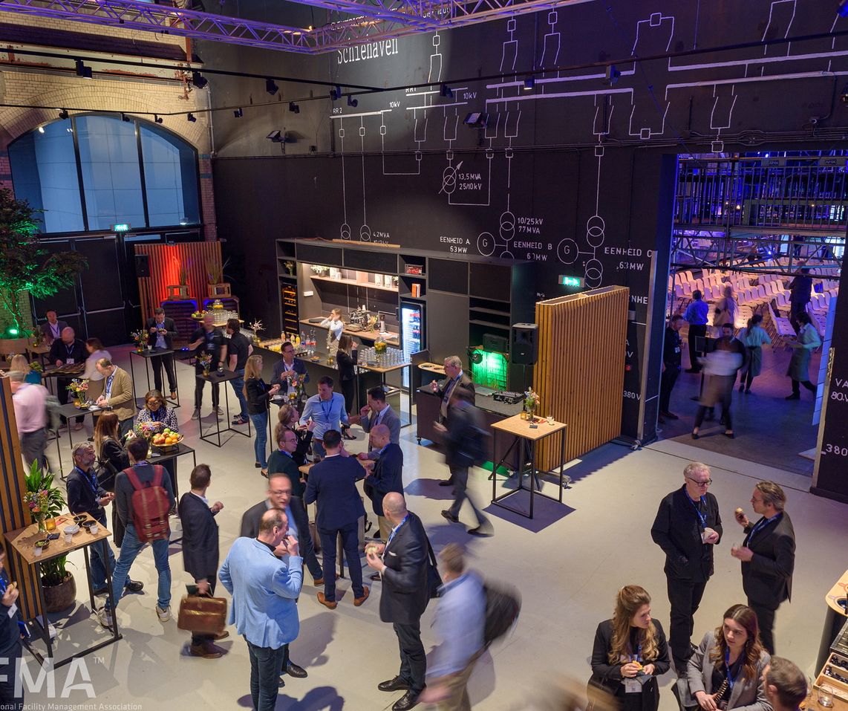
12-13 March
I’m Attending
Europe’s leading conference for
facility management professionals!
worldworkplaceeurope.ifma.org

Slide 3
12-13 March
I’m Attending
Europe’s leading conference for
facility management professionals!
worldworkplaceeurope.ifma.org

Slide 4
12-13 March
I’m Attending
FName LName
Europe’s leading conference for
facility management professionals!
Title
worldworkplaceeurope.ifma.org

