Slide 1
Title Goes Here
Write Subtitle
Presenter name, title

Slide 2
Overview
Introduction
1
Objectives
2
Main Content
3
Recap
4
Questions
5

Slide 3
Slide title goes here
Your content should be placed here...
Your content should be placed here...
Your content should be placed here...
Your content should be placed here...
Your content should be placed here...

Slide 4
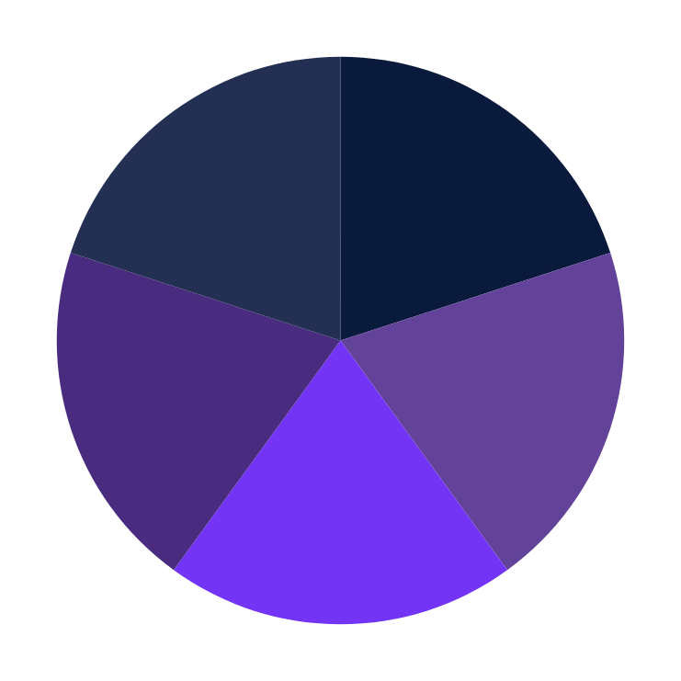
Chart Page
Elaborate on what you want to discuss.
Elaborate on what you want to discuss.
Elaborate on what you want to discuss.
Elaborate on what you want to discuss.
Elaborate on what you want to discuss.

Slide 5
Slide title goes here...

Slide 6
Slide title goes here
01
02
03
04
Topic Title
Topic Title
Topic Title
Topic Title
Your content should be placed here... Your content should be placed here... Your content should be placed here...
Your content should be placed here... Your content should be placed here... Your content should be placed here...
Your content should be placed here... Your content should be placed here... Your content should be placed here...
Your content should be placed here... Your content should be placed here... Your content should be placed here...

Slide 7
CEUs & CFM® Maintenance Requirements
CEU CODE FOR THIS SESSION: <add CEU code>
To receive CEU points, you must add the US$25 processing fee to your registration.
All CEU participants are required to complete the session evaluation, five question assessment and CEU session code for each session attended. After passing the test, your electronic CEU certificate can be downloaded from the Attendee Service Center.
Managing CEUs Instructions*:
Log into the Attendee Service Center.
Your log-in information was sent to you when you registered for the conference.
Click “Start CEU Process” on the left-hand side.
Click “Start” next to the session you attended.
Complete the session evaluation.
Complete the five-question assessment and CEU session code.
After passing the test, your attendance will be verified, and a certificate can be downloaded from the Attendee Service Center.
*If you wish to receive CEUs or LUs for other organizations, you must contact those organizations for instructions on reporting credit hours.
To receive 1 CFM Maintenance Activity (6 required for recertification)
CEUs are not a requirement for CFM maintenance activities.
Record your attendance for the three-day conference on your CFM Recertification Form in CAMP.
Credentials Staff can verify your attendance.
At re-certification time, submit your completed CFM Recertification Form.

Slide 8
We value your feedback! Please take the time to evaluate sessions on
the Mobile App.
1. Log into your Mobile App.
2. Access the current session.
3. Click on “Session Feedback” to rate the session.
Thank you for your participation!

Slide 9
Write the presenter's name
Thank you!
for attending!

